Slide 1
Chapter 5: Channel Coding

Slide 2
Introduction
Overview of code design
Linear block codes
Convolutional codes
Coding with interleaving for fading channels

Slide 3
Position of channel coding
Source
Source
coding
Channel
coding
Pulse
shaping
Mod
Analog
Waveform
Baseband
signal
RF
signal
Wireless
channels
Infor. bits
Coded bits
Destina
tion
Source
decoding
Channel
decoding
Sampling
detecting
Demod

Slide 4
Basic concept of channel coding
Embedding signal in higher-dimension space
Example:
  Repetition codes
001
011
101
111
000
010
100
110
Notes:
Increase space dimension = Channel is used for more times.
Distance between points is increased.

Slide 5




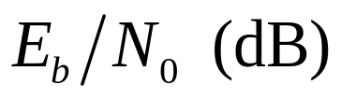
Performance with channel coding
Capacity
Coded
Uncoded

Slide 6
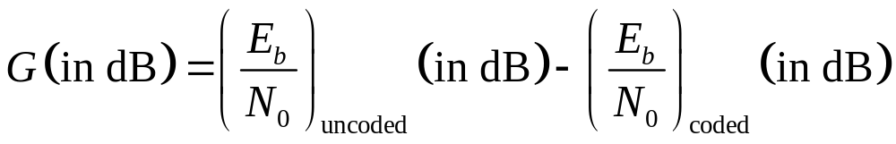
Why use error correction coding
Trade-off:
  Error Performance vs Bandwidth
  Power vs Bandwidth
  Data Rate vs Bandwidth
  Capacity vs Bandwidth
  Coded vs Uncoded Performance
Coding Gains
  For a given bit-error probability, coding gain is defined as the reduction in E_{b}/N₀ that can be realized through the use of code.

Slide 7
Types of channel coding
Block codes
  Hamming code
  BCH code
Convolutional codes
  Recursive or Nonrecursive
  Systematic or Nonsystematic
Reed-Solomon codes
Interleaving and concatenated codes
Turbo codes

Slide 8

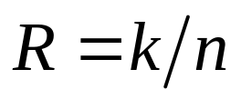


Linear block codes
Definition of block codes
Information is divided into blocks of length k .
r parity bits are added to each block.
Total length:
Code rate:
For binary block codes
Input: different information blocks
Output: codewords from possibilities

Slide 9
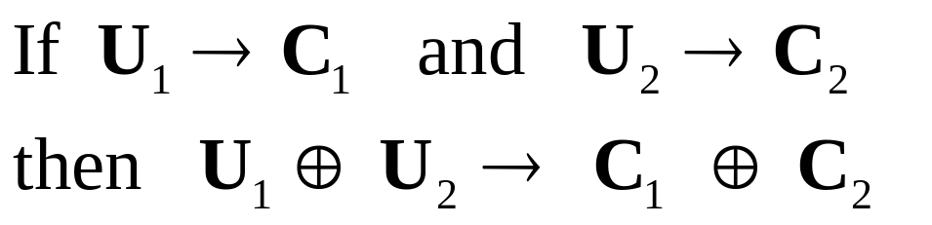
Definition of binary linear code
Linearity:
Properties:
  The sum of any two codewords is a codeword.
  The all-zero sequence is a codeword in every linear block code.

Slide 10
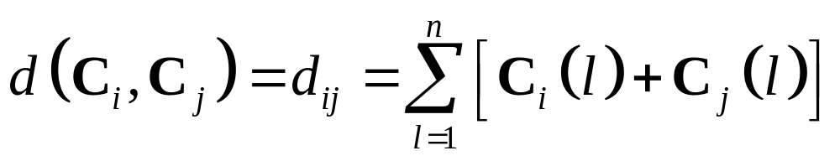
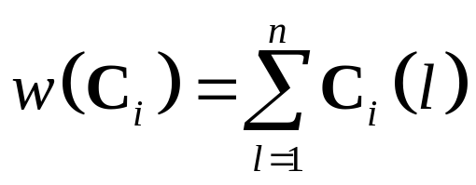
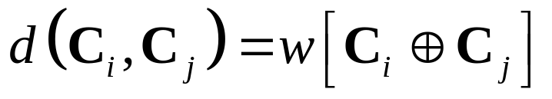
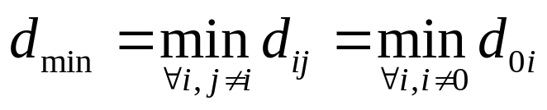
Codeword distance – Hamming distance
To describe how “close'' are two codewords
The number of bits that two codewords differ
By defining the weight of a codeword as
  Then
Minimum distance of a code

Slide 11
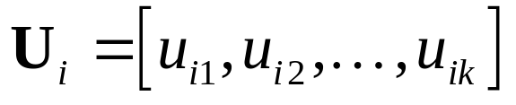
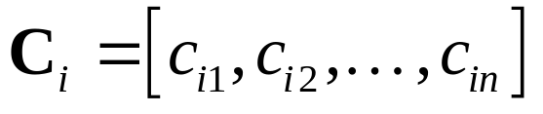
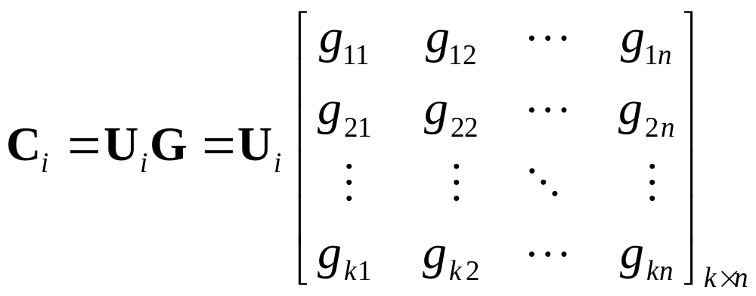

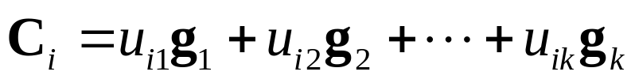
Generator matrix
The parity bits of linear block codes are linear combination of the information bits. Therefore, we can represent the encoder by a linear system described by matrices
For a k-bit information block,
Its corresponding codeword is

Slide 12
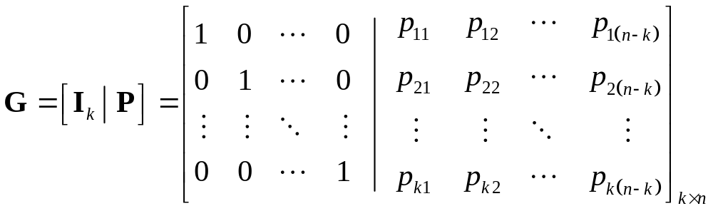
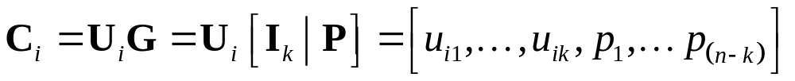
Systematic linear block code
The generator matrix
The first k bits of the codeword are the original information bits

Slide 13
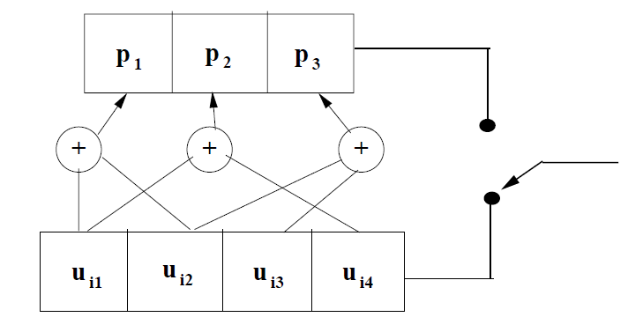
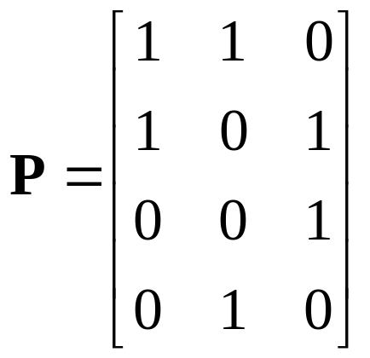
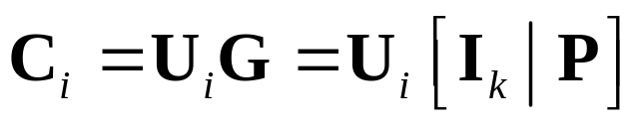
Circuit for encoding – An example
output
input

Slide 14
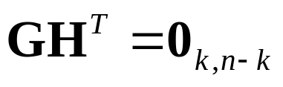
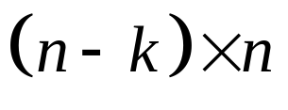
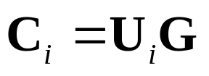
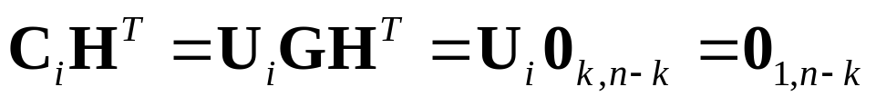
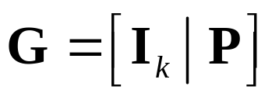
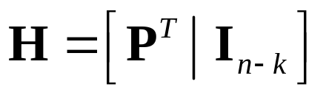
Parity-check matrix
A parity-check matrix is a matrix that satisfies
The size of H is .
Since , then
  To determine a valid codeword or not.
For a generator matrix , the parity-check matrix is
Notes:
Transpose of a matrix A^T

Slide 15

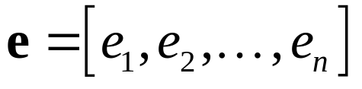

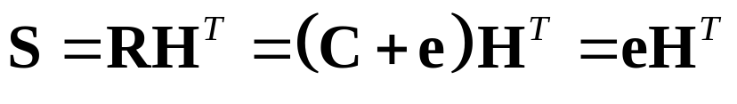


Syndrome testing
Let C be transmitted and R be received
Where is the error pattern
Define the syndrome of R as
If R contains correctable errors, the syndrome identifies the error pattern
The syndrome is a function only of , not .

Slide 16



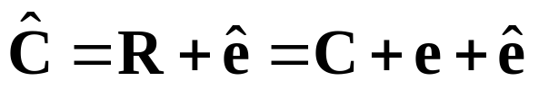
Correcting
corresponds to n-k equations in n unknowns
2^{k} possible error patterns for a given syndrome.
If an error pattern is the most likely error associated with a given syndrome .
The transmitted codeword is decoded as

Slide 17
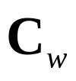
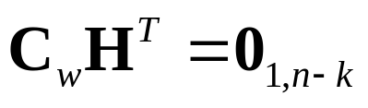
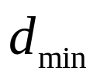

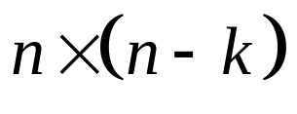
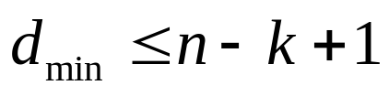
Singleton bound
Let denote a non-zero codeword in a given (n, k) code with minimum weight
The sum of rows of , these rows are linear dependent.
The size of is
An upper bound

Slide 18
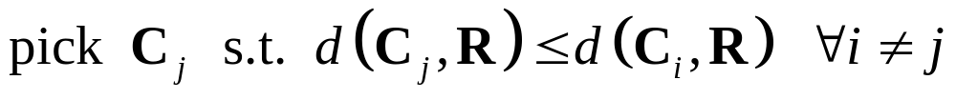
Hard decision decoding (HDD)
Each coded bit is demodulated as 0 or 1.
Each coded bit is detected individually.
Minimum distance decoding based on Hamming distance
Which one among the 2^{k} possible codewords has the minimum distance to the received codeword R.

Slide 19
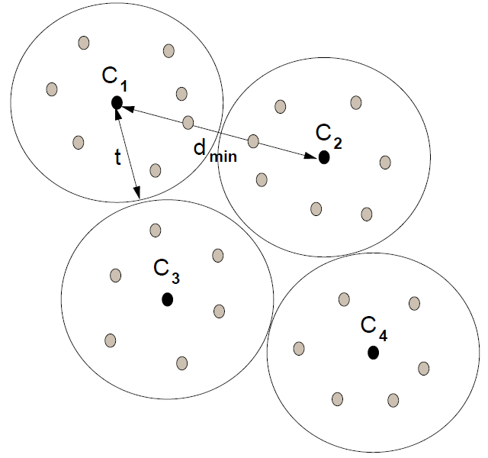
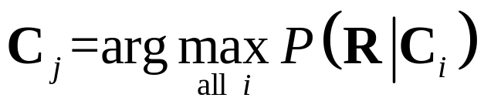
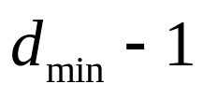
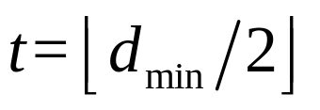
Maximum likelihood decoding
The transmitted codeword that has the highest probability of having produced the received codeword.
Maximum number of error
bits can be detected.
Maximum number of error
bits can be corrected.

Slide 20
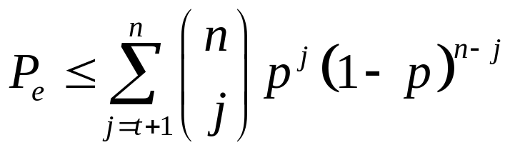
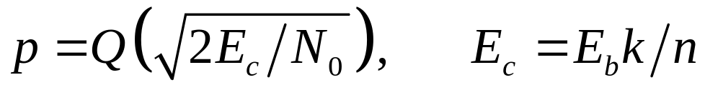
Probability of error for HDD in AWGN
A decoding error happens when more than t coded error bits are detected wrong
Bit errors in a codeword occur independently on an AWGN channel
For BPSK

Slide 21
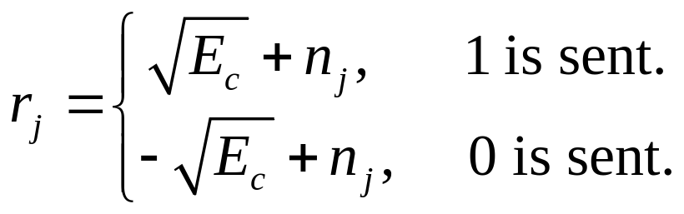
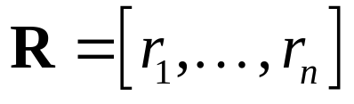
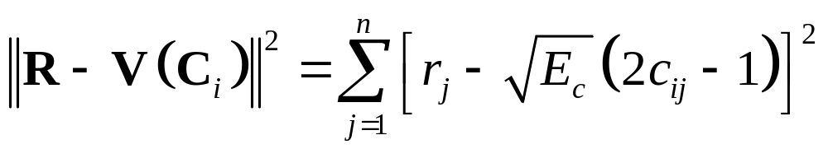
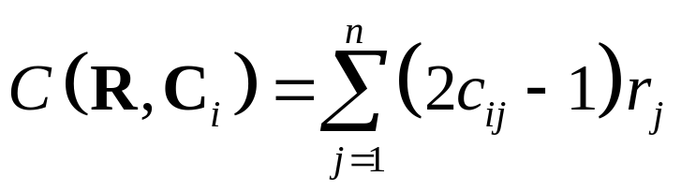
Soft decision decoding (SDD)
The distance of the received symbol from the transmitted constellation is used in decoding.
Assume BPSK
The received codeword .
Compare Euclidean distance
Equivalent to comparing the correlation metric

Slide 22

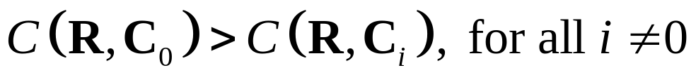
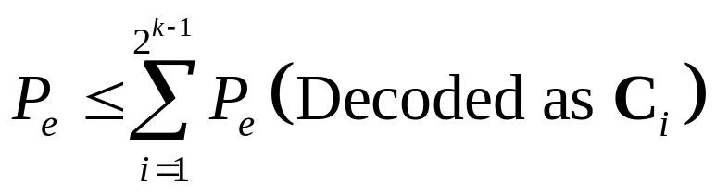
Probability of error for SDD in AWGN
For an AWGN channel, the probability of codeword error is the same for any codeword of a linear code.
Assume the all-zero codeword is sent, for the received codeword, if correctly decoded,
Error probability
Union bound

Slide 23
Outline of convolutional code
Convolutional Code Structure
  Encoder Structure
  Trellis diagram
  Transfer function of the convolutional code
Decoding Algorithm
  Viterbi Decoder
Performance bound and analysis
  Performance of AWGN

Slide 24






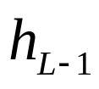
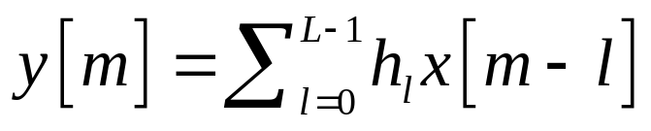
Convolution operation
Regard the multipath channel as a L-length shift register, L is the length of its state.

Slide 25
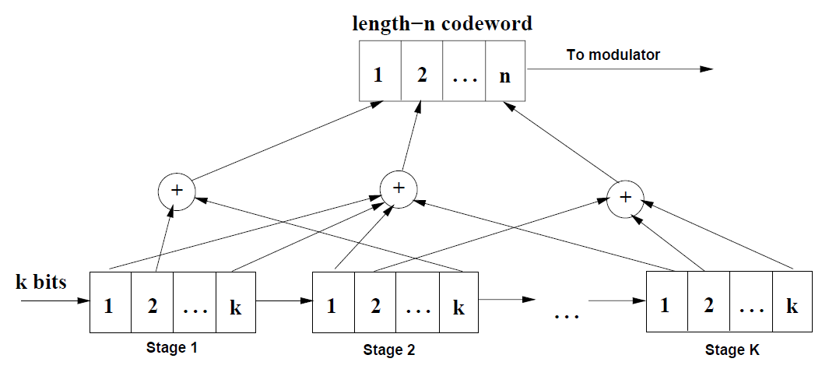

General structure of convolutional code
Constraint length is bits, or K k-bit bytes.

Slide 26
Encoder structure
Map k bits to n bits using the previous (K-1)k bits
Rate k/n code with constraint length K
n generators, each is a binary vector with Kk bits long
In the following, we consider only the case where k=1 (easily extendable)

Slide 27
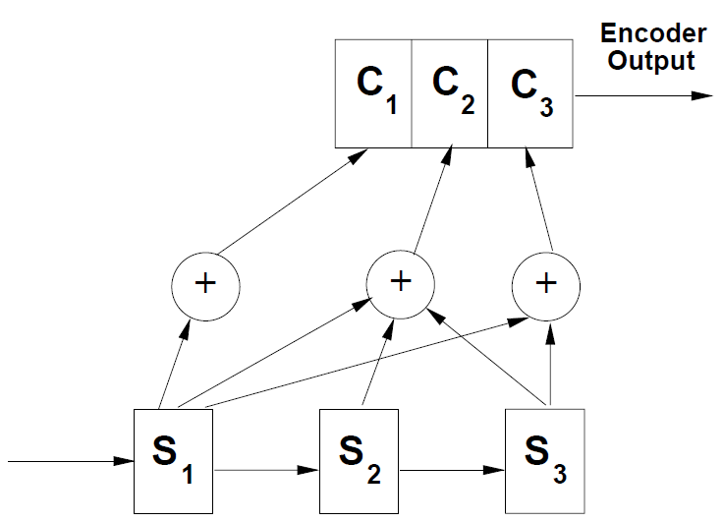

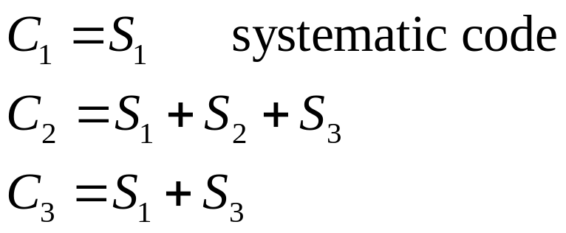
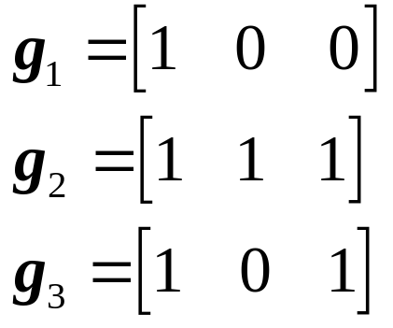
Example

Slide 28


Linear code property of C.C.
Generation Matrix
Kk
g₁
n
g₂
g₃

Slide 29

Trellis diagram

Slide 30

Description of trellis diagram
State is composed of K-1 previous input bits
  There are different states.
Current input bit is shown as the branch between two adjacent states – state transition.
Output is the bit sequence along with the branch.
For an input bit sequence, the encoding correspond to a path in the trellis diagram, and
the output bit sequence is the concatenation of the bit sequences along with that path.

Slide 31
An encoding example
Input bit sequence: 1 0 1 0 0
Output : 111 010 100 010 011

Slide 32



Decoding algorithm
Transmit a codeword using a digital modulation scheme (e.g. BPSK or QPSK)
Received
Maximum likelihood decoder:
Minimize the Prob of error if C is equally likely
Let the channel be memoryless (e.g. an AWGN channel)

Slide 33




Log likelihood function
Definition
For memoryless channel
is the likelihood function of the j-th coded symbol in the i-th stage.
Branch metric is defined as
Multiplication is replaced by addition.

Slide 34


Hard decision decoding
The received signal is decided as 0 or 1 first before decoding.
Denote the error probability in hard detection as p.
If the hard detected sequence and the codeword are N symbols long and differ in d places, then
Since p<0.5 , maximizing is equivalent to minimizing d.

Slide 35


Soft decision decoding
For BPSK over an AWGN channel,
The likelihood function
Branch metric

Slide 36


Log likelihood function
After some manipulations,
The comparison among different codewords depends only on the term .

Slide 37


Decode algorithm
ML decoding is equivalent to
Equivalent branch metric

Slide 38
ML decoding procedure
Compute for each branch, the branch metric using the output bits associated with that branch and the received symbols R .
Compute, for each valid path through the trellis (a valid codeword C), the sum of the branch metrics along that path.
The path with the maximum accumulated value is the decoded path.
The problem is that the number of paths grows exponentially with the codeword length and K.

Slide 39





Viterbi algorithm
At this point, we can eliminate one of these two paths
Let be the maximum path metric (accumulated branch metric) from to .
Notes:
行车路线的例子

Slide 40





Procedure in Viterbi algorithm
Initialization:
For i=1 to L, repeat
  Compute
  Compute for each state
  for every state s that goes to state s’ in one branch.
  Store the state that minimizes the PM in .

Slide 41

State diagram and transfer function
Transfer function is used to characterize paths that diverge and remerge from the all-zero path
diverge
remerge

Slide 42



Derivation
State equations
Transfer function of the code

Slide 43

Entended state diagram
D: Hamming distance for each branch
J: to count the number of branches
N: to count the number of “1” input bits.

Slide 44



Derivation for extended state diagram
State equations
Transfer function of the code

Slide 45


Performance analysis of C.C. in AWGN
Because of its linear code property, assume that the all-zero sequence is transmitted.
The first error event probability of two paths differ in d coded bits (BPSK symbols)
Based on Union bound, we obtain an upper bound of the probability of mistaking the all-zero path for another path through trellis

Slide 46


Relation with code transfer function
By using Chernoff bound
Then, an upper bound of the first error event probability is given by

Slide 47


Performance analysis for bit error rate
If we have for a code
  For paths with weight d, a_{d,n} of them corresponds to an information sequence with weight n. Hence, error decoding to such path leads to n information bit errors.
Then, the upper bound of bit error probability
Notes:
Bit error 即使发生在多段也没关系，在多段上的BER 等于在 一段上的 BER，因为BER的定义是错误的bit除以所以发送的bit。

Slide 48
Coding with interleaving for fading channels
In fading channels, errors associated with the demodulator tend to occur in bursts.
  Especially when the channel is in a deep fade.
Codes such as block codes, convolutional codes for AWGN channels cannot correct long burst errors.
In fading channels, these codes should be combined with interleavers.
In fading channels, maximizing the diversity order instead of increasing Euclidean distance in AWGN channels.

Slide 49

Achieving time diversity
Time diversity can be obtained by interleaving and coding over symbols
across different
coherent time periods.
Coding alone is
not sufficient.

Slide 50

Example in GSM
UL: 890~915 MHz DL: 935~960 MHz
577 us
4.615 ms
Each 200 kHz sub-channel is further divided into time slots for eight different users. TMDA

Slide 51



Example:GSM
4.615 ms
Amount of time diversity limited by delay constraint and how fast channel varies.
In GSM, delay constraint is 40ms (voice).
To get full diversity of 8, when the carrier frequency is
, the speed needs .

Slide 52
Summary
Overview of code design
  Concepts such as linear code, code rate i.e..
Linear block codes
  Encoding and decoding methods
  Performance of HDD and SDD
Convolutional codes
  Encoding and decoding methods, Viterbi algorithm
  Performance analysis
Coding with interleaving for fading channels
  Focus more on achieving time diversity gain.
Homework: 8-1, 8-2, 8-14, 8-15(a,b,c)

